Slide 1
AACS3013 Database Development and Application
Database presentation

Slide 2
Organization Structure

Slide 3
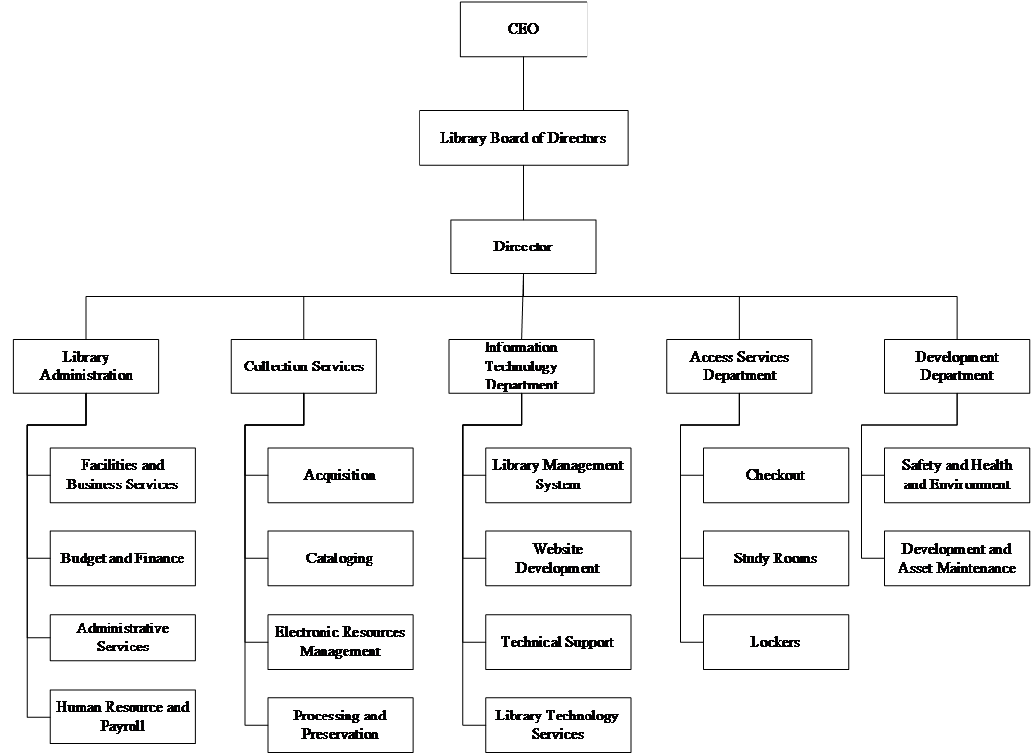

Slide 4
Functional Diagram

Slide 5
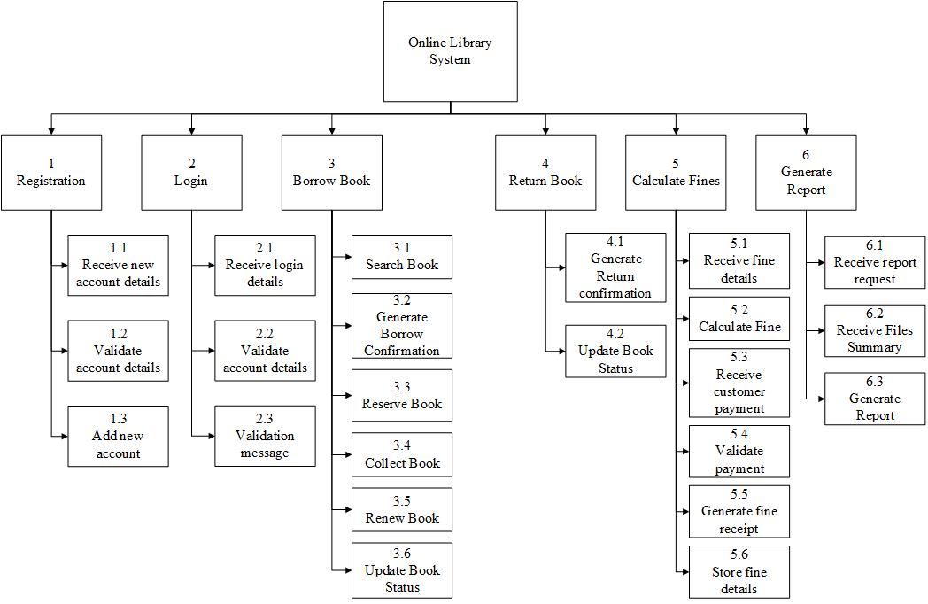

Slide 6
Business Rules

Slide 7
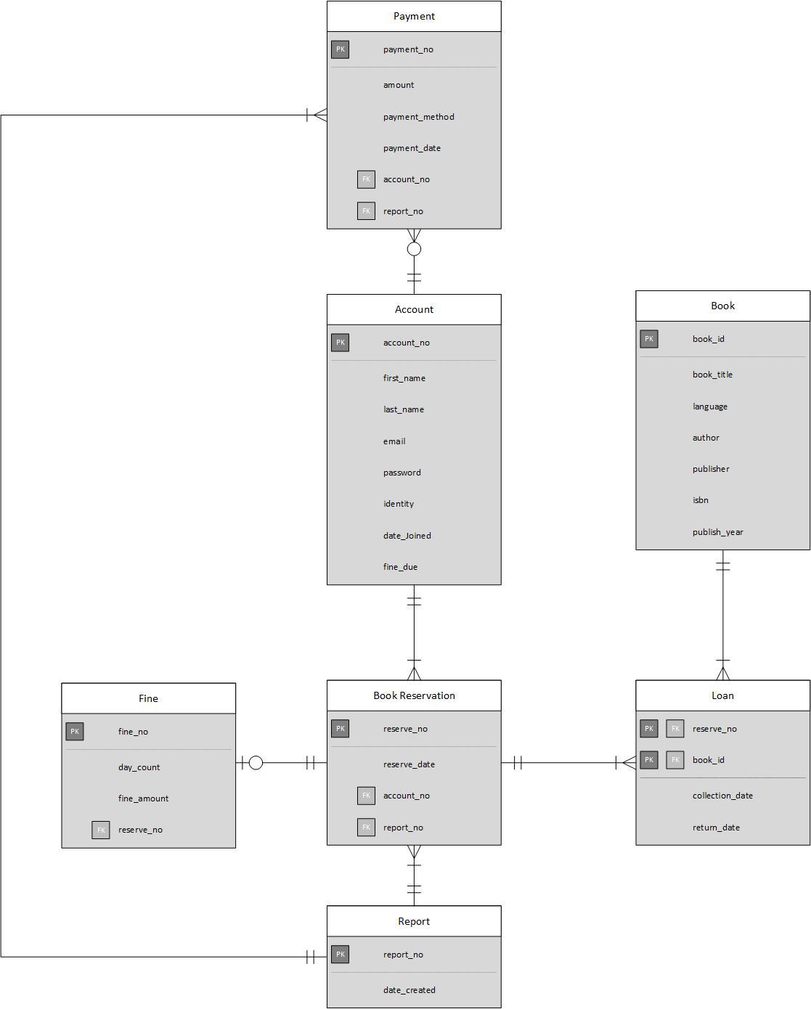
An account can reserve many books. A book reservation belongs to only one account.

Slide 8
An account can make payment on many fine. A fine can only be paid by one account.

Slide 9
A book reservation can reserve many books. A book can be reserved by many books.

Slide 10
A book reservation can have one or no fine. A fine only belongs to a book reservation.

Slide 11
A report obtains all information from payment record.

Slide 12
A report obtains all information from book reservation record.

Slide 13
ERD Diagram

Slide 15
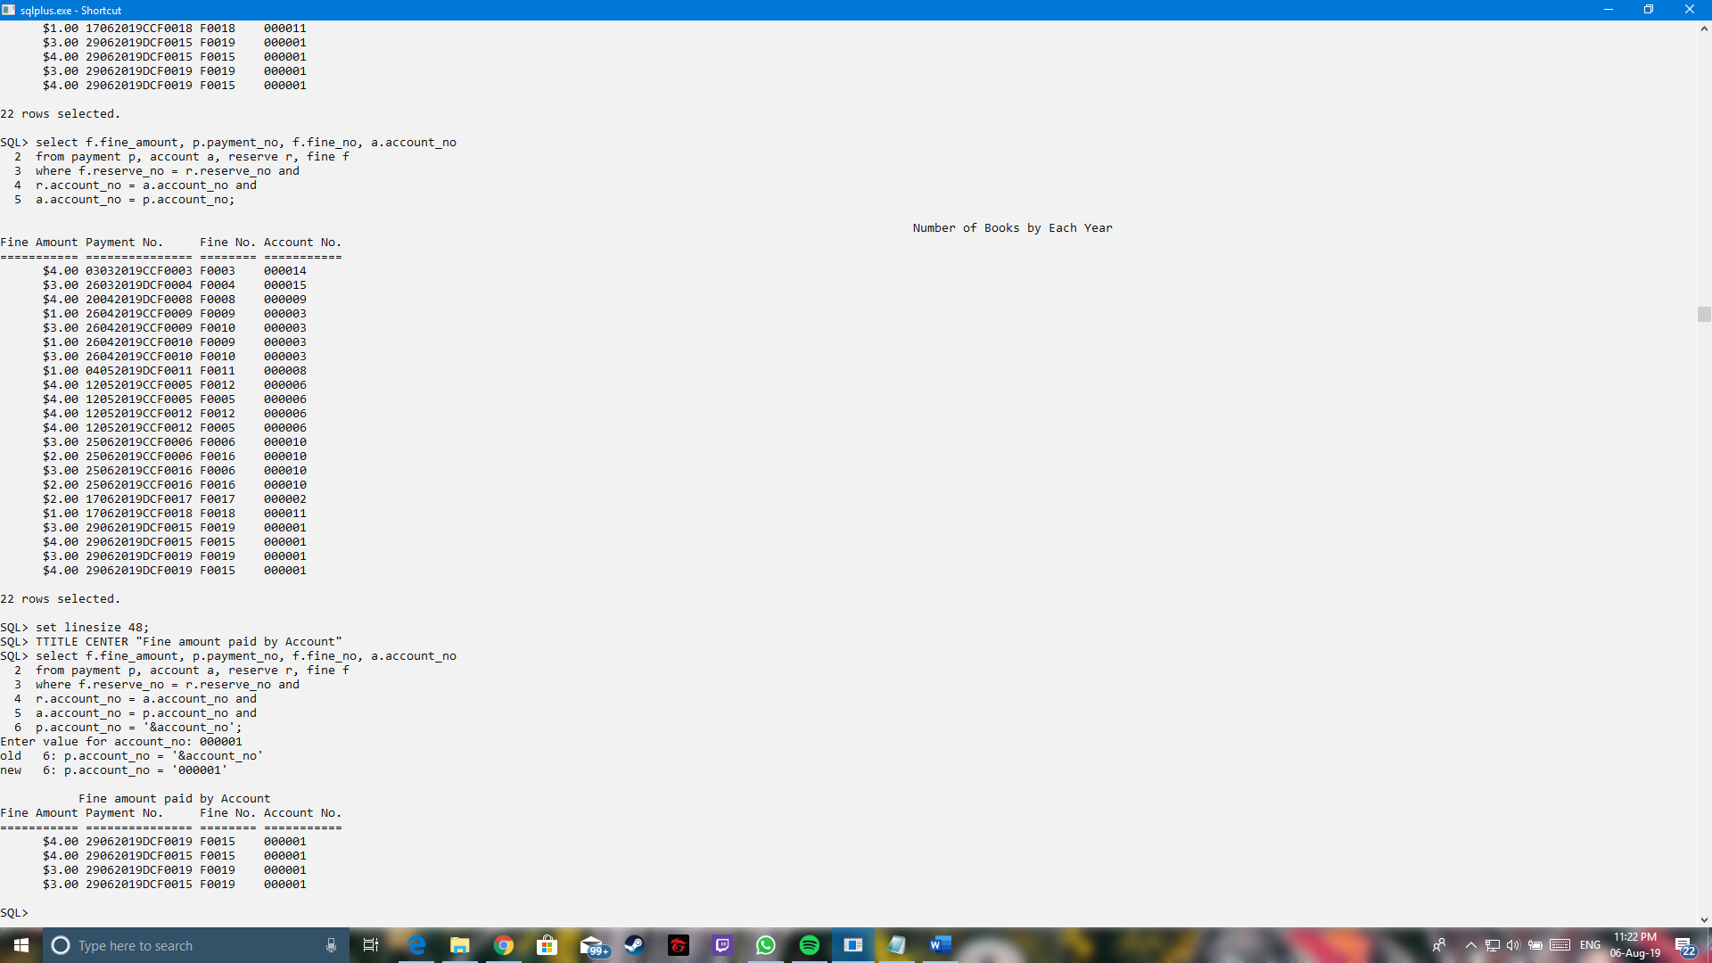
Queries
Purpose:
To make the user easier to search for fine amount paid by certain accounts. This function can be used to increase the efficiency of the staff to perform their work.

Slide 16
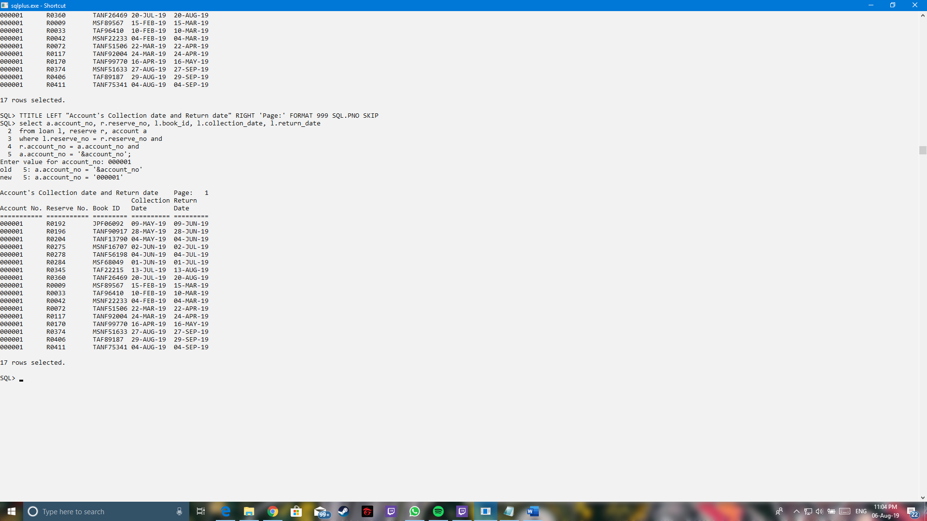
Queries
Purpose:
To make the user easier to search for collection date and return date by certain accounts. This is to increase the efficiency of the staff to perform the searching of the accounts’ details.

Slide 17
Conclusion

Slide 18
Limitation of our Database
Limited Reserve Number
Limited Report Number
Complex Queries
Future Works
Get used to the SQL commands

Slide 19
Group Reflection

Slide 20
The End

